Slide 1

Capstone 2: Applied Machine Learning For Daily Fantasy Hockey
Michael Wood
Springboard Data Science Capstone 2
September 2019

Slide 2
Why Daily Fantasy Hockey?
By even the most conservative estimates daily fantasy sports is a multi-billion dollar industry, the largest volume of which is moved for fantasy football but the sites at this point cover everything down to e-sports and MMA.¹
For this capstone project the intent was to cover if machine learning models could be trained to be sufficiently competitive for daily fantasy contests in hockey, a sport that is widely considered the most difficult to predict due to the level of variance, interaction among players, and general ‘puck luck’. ²

Slide 3

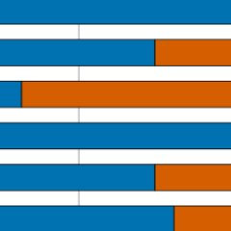
Data Collection
The data scraped from the NHL’s unofficial API, and then processed using scripts developed by the team at EvolvingHockey¹, an invaluable resource for daily results.
Notes:
Evolving Hockey also deserve credit for

Slide 4
Preprocessing And Primary Feature Gathering
For this project most of the data was in a raw format from the API and required compiling on a player-per-game instance. That was assisted by the Evolving Hockey scripts, but also required a PostgreSQL instance be stood up to house the data and easily access it, as well as create rank ordering functions.
Additionally, significant was done to break the api scraping down into chunks to reduce the load on the local machine.

Slide 5
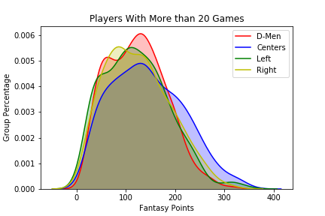
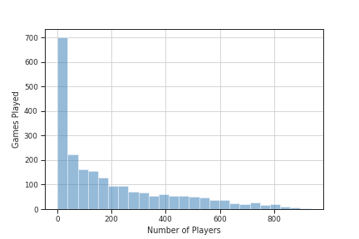
Data Exploration
The Target Metric, Fantasy Points, are not evenly distributed as they are across a season. Below are points on a per-season basis (left) and on a per-game basis (right). This significantly complicates forecasting.

Slide 6
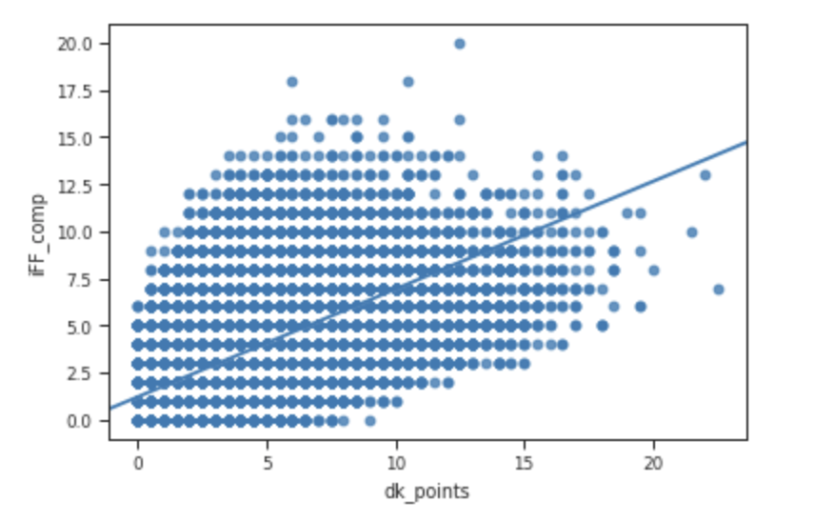
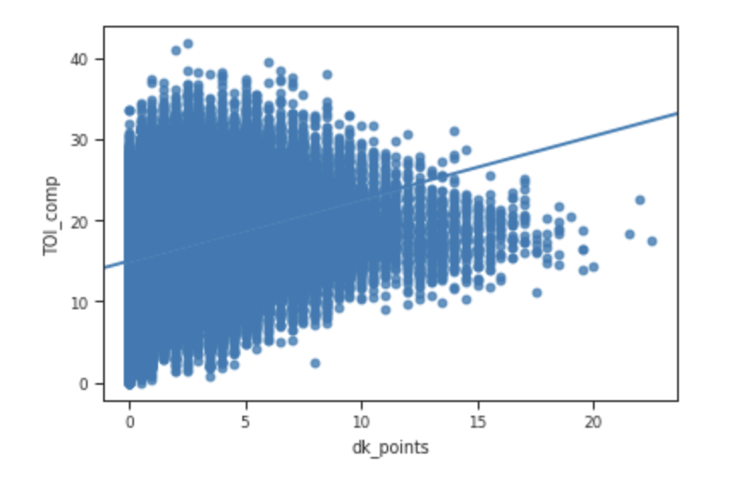
Data Exploration
Time on ice (left) remains the constant for forecasting points, as predictive and almost as correlated as core possession metric, Fenwick (right).

Slide 7
Applied Market Forecasting Theories: Moving Average Convergence
The 'Hot Hand Theory' might be the original piece of sports analytics work, and certainly the most discussed and dissected. Here we propose a slightly different take, which is to apply financial methods of finding trends to identify values. While there is significant value in a players past overall performance, but being able to spot immediate trends creates a near term arbitrage opportunity where players are undervalued but on an upswing.
The theory in this case is that since time on ice and time on the power play are the biggest indicators of success, rivaled only by possession metrics, if a model could detect an upward trend it could find undervalued players in advance and forecast positive events.
While global movements are relatively rare, line shifts are frequent, sometimes happening in-game, and identifying when a player is seeing increased deployment over their previous shifts is highly valuable. A signal metric was developed to identify those events.
Notes:
The 'Hot Hand Theory' might be the original piece of sports analytics work, and certainly the most discussed and dissected. Here we propose a slightly different take, which is to apply financial methods of finding trends to identify values. While there is significant value in a players past overall performance, but being able to spot immediate trends creates a near term arbitrage opportunity where players are undervalued but on an upswing.
The theory in this case is that since time on ice and time on the power play are the biggest indicators of success, rivaled only by possession metrics, if a model could detect an upward trend it could find undervalued players in advance and forecast positive events.
Worth noting is that these financial methods have also been heavily critiqued, perhaps most notably by the legendary Burton Malkiel, but where they fail in financial markets they could very well succeed in this use case. The most frequent critique of 'Chart watchers' and 'market timers' is that they are using prior information to fill in future assumptions, while the efficient market theory states that there is far more current information that is readily available and therefore the market price at current time isn't based on past pricing. In this case, we do not have more current information or insight into why a player is seeing more time; they might have been moved due to injury or a trade. Even if we do have some of that information for some players via say Twitter or trade trackers, coverage isn't global and we don't have an efficient way to find out if a player will see an increase in ice time. Therefore, finding a moving average might well be an effective signal to show that a player's points will soon increase as well.

Slide 8
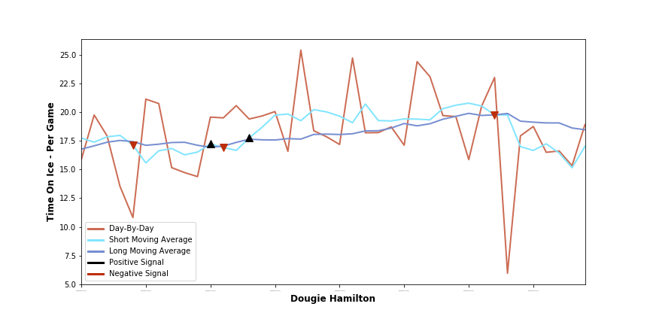
Applied Market Forecasting Theories: Moving Average Convergence
Here is a random sample of players with the positive (black arrow) and negative (red arrow) signal markers overlayed on top of the moving averages (blue and dark blue lines). Note how the black arrow frequently proceeds a distinct upward trend in the moving averages.

Slide 9
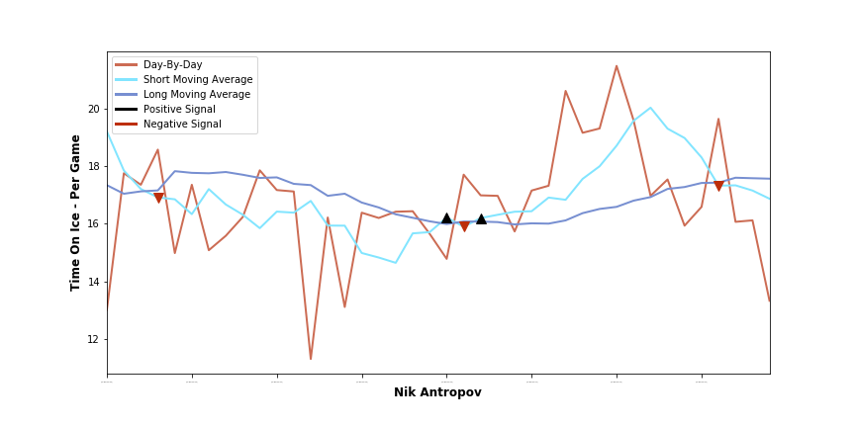
Applied Market Forecasting Theories: Moving Average Convergence
Here is a random sample of players with the positive (black arrow) and negative (red arrow) signal markers overlayed on top of the moving averages (blue and dark blue lines). Note how the black arrow frequently proceeds a distinct upward trend in the moving averages.

Slide 10
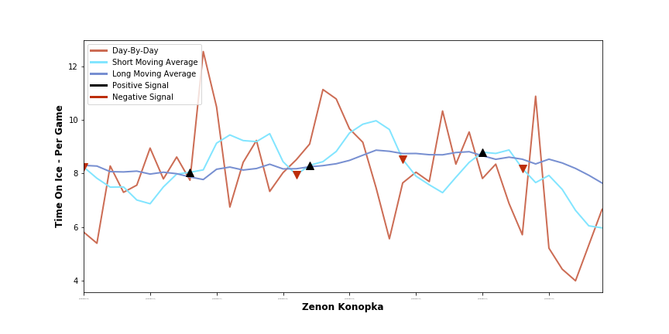
Applied Market Forecasting Theories: Moving Average Convergence
That said the model can be ‘psyched’ out, as seem here, by highly uneven deployment which could be caused by a number of factors.

Slide 11
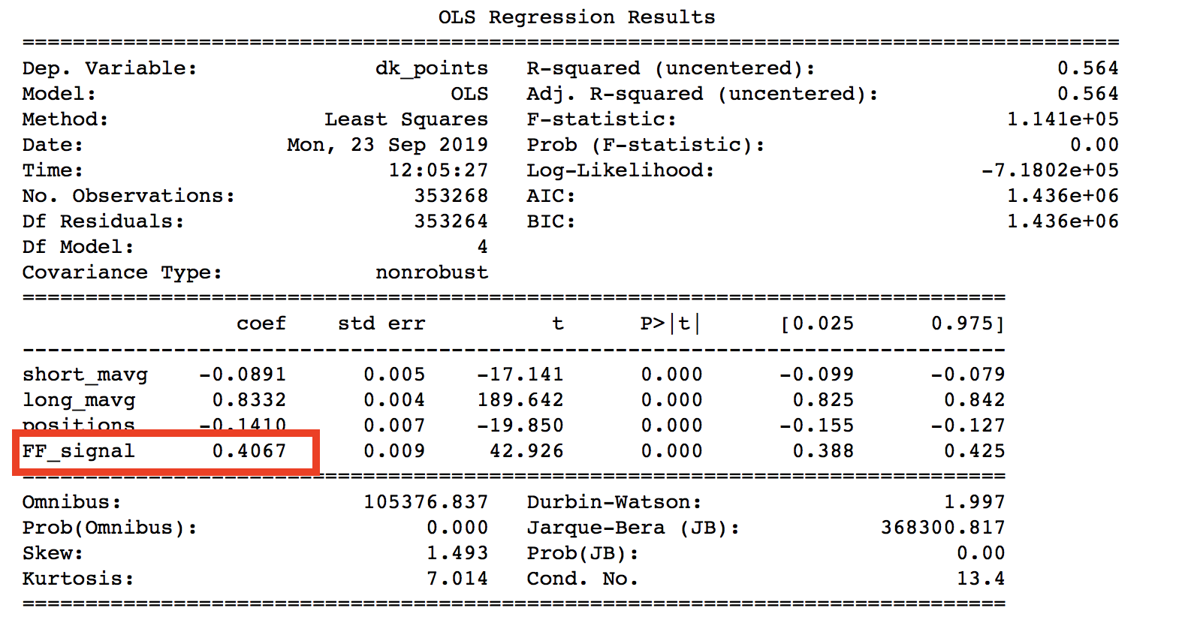
Applied Market Forecasting Theories: Analysis
Most promising, when used in an OLS model both signals had very positive linear outcomes, adding nearly a half point, or a quarter standard deviation improvement for a positive signal.

Slide 12
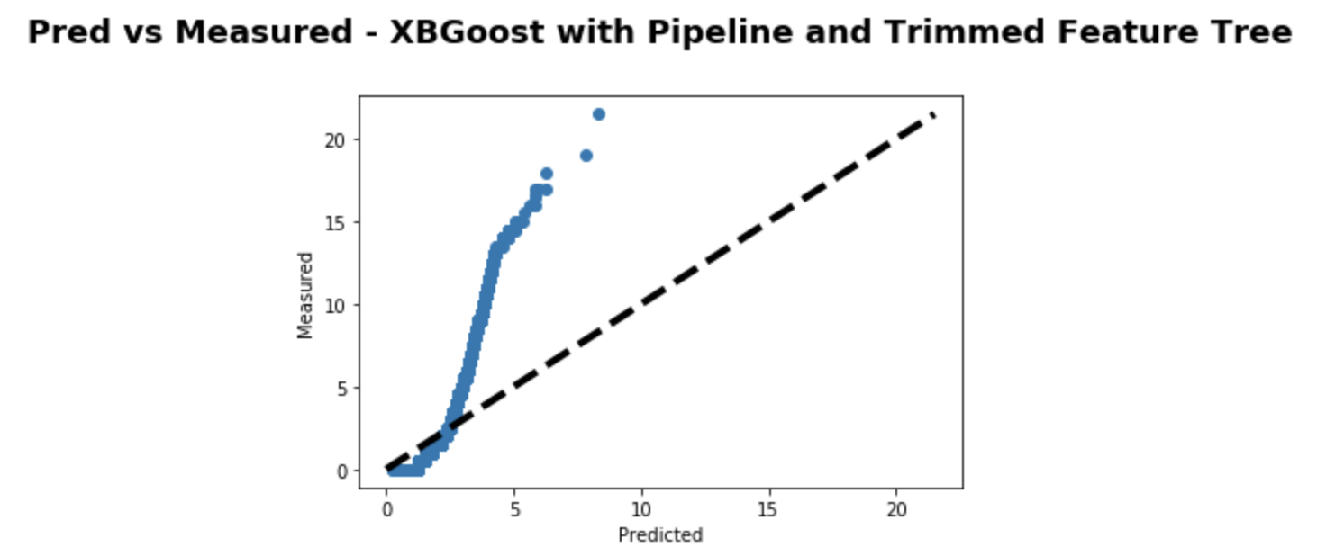
Model Building: Initial Failure
Initially three models were employed; Stochastic Gradient Decent, Random Forests, and Gradient Boosted Regressors. These failed in spectacular fashion. Below is a chart of the predicted vs actual values with the best performing model of that group.

Slide 13
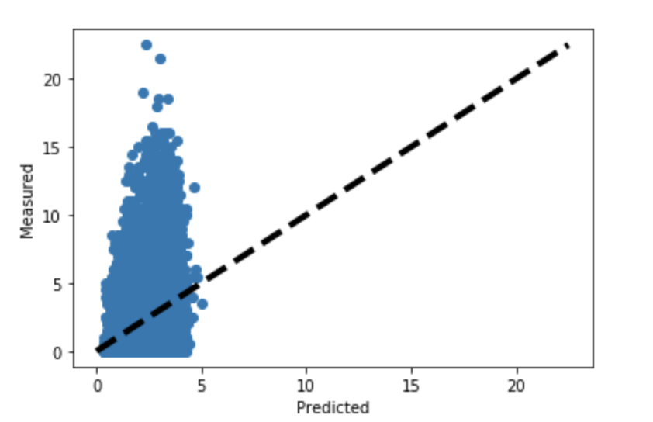
Model Building: Initial Failure
The problem here is two-fold: one, upon performance of a Variance Inflation Factor (VIF) analysis it was confirmed that the features were highly correlated amongst themselves and thus multicollinear, the models have a hard time sifting out worthwhile metrics when the target variables are so skewed and thus the results end as an amorphous blob with most values being projected as the mean with little ability to create separation. This is another charting of the results which shows this in clearer fashion.

Slide 14
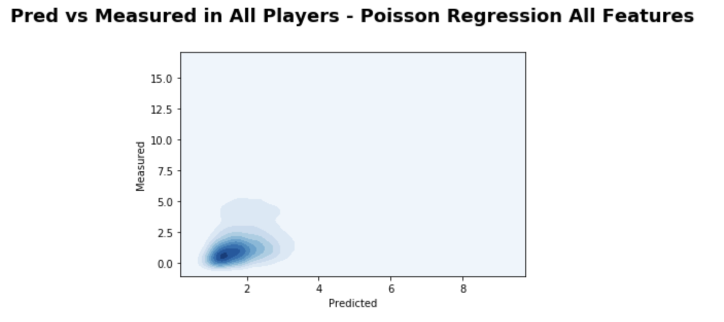
Model Building: Moderate Success
In order to try and deal with these issues a new model was employed using Poisson Regression Model which is better suited to the purpose given the timebound nature of the contests with a discrete probability of each event occurring. While this did not yield a perfect distribution it was significantly better at predicting the range of values that might occur.

Slide 15
Application
In order to further validate the success of this program the model was build it was tested using FantasyCruncher, a tool which is considered an essential lineup optimizer by most daily fantasy sports professionals. This site does the difficult leg work of maximizing points per lineup, a computationally difficult problem, while allowing you to easily import your own models and calculate line performance based on those.
Five days were chosen at random, three of which had data in FantasyCruncher, 2/23/2016, 5/11/2016, and 10/27/2018. Then the model was imported and then compared to a generic projection provided by FantasyCruncher.

Slide 16
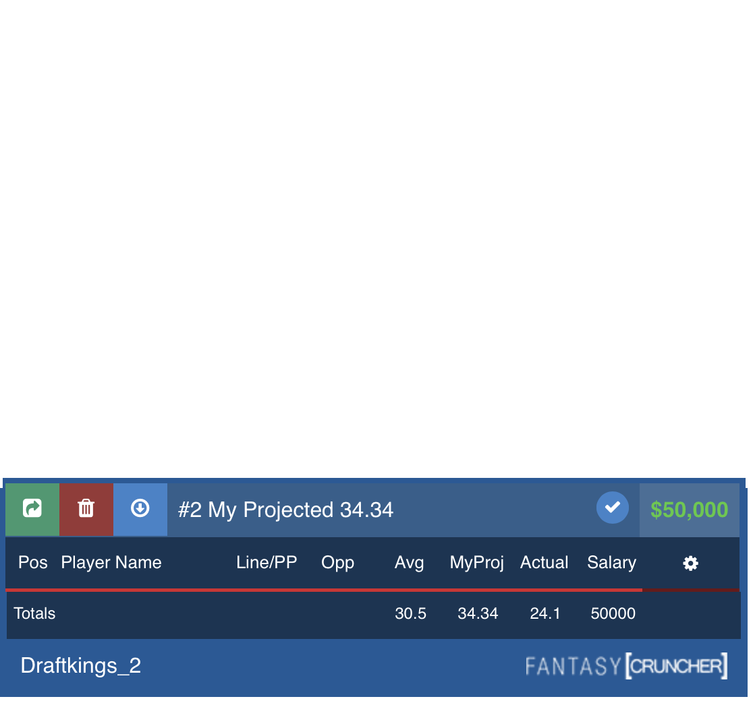
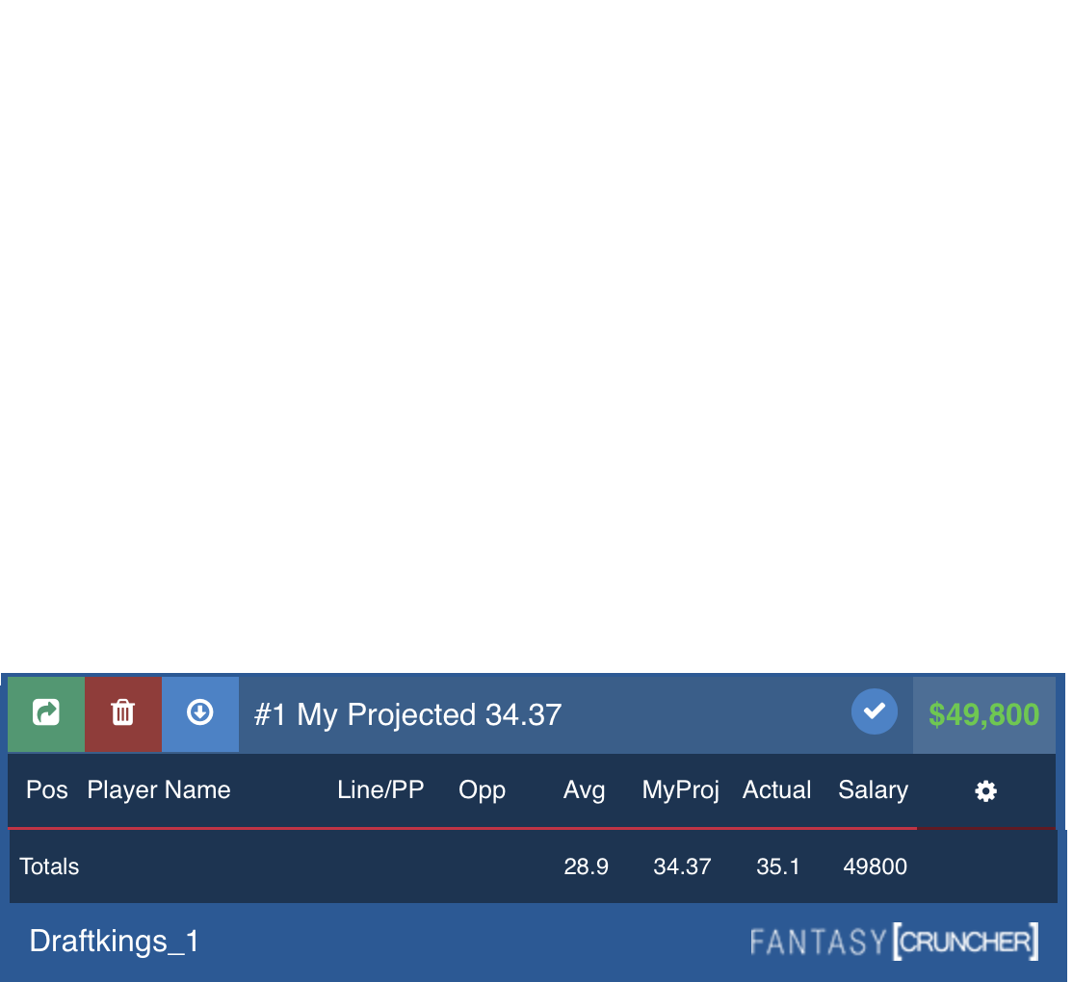
Naïve Application
In naïve contests without player input, the model did not perform significantly differently than the off-the-shelf projections, and in fact was de-prioritized by the platform. Below is a comparison of the naïve lineups for the model (upper left) and FantasyCruncher (lower right):
It’s important to note the typical lower bound for scoring is 35 points so given that target the fantasycruncher contest would have succeeded while the naïve model would not.

Slide 17
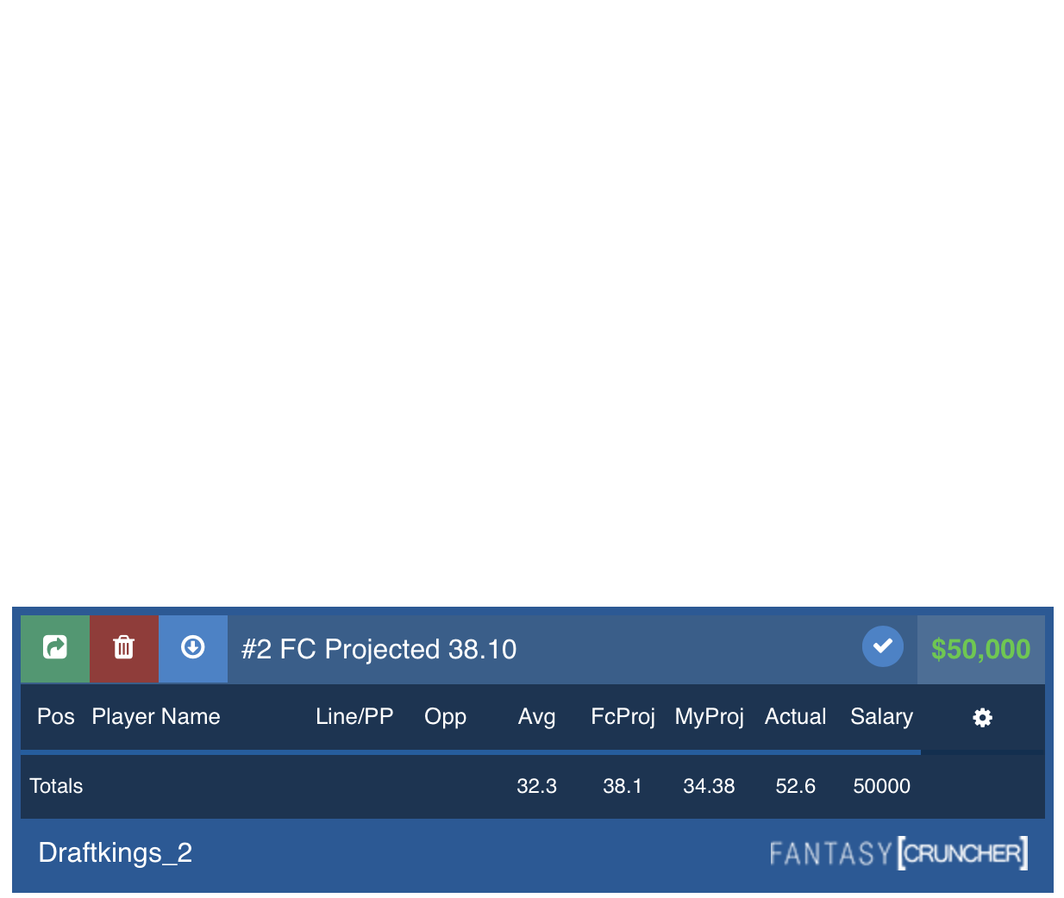
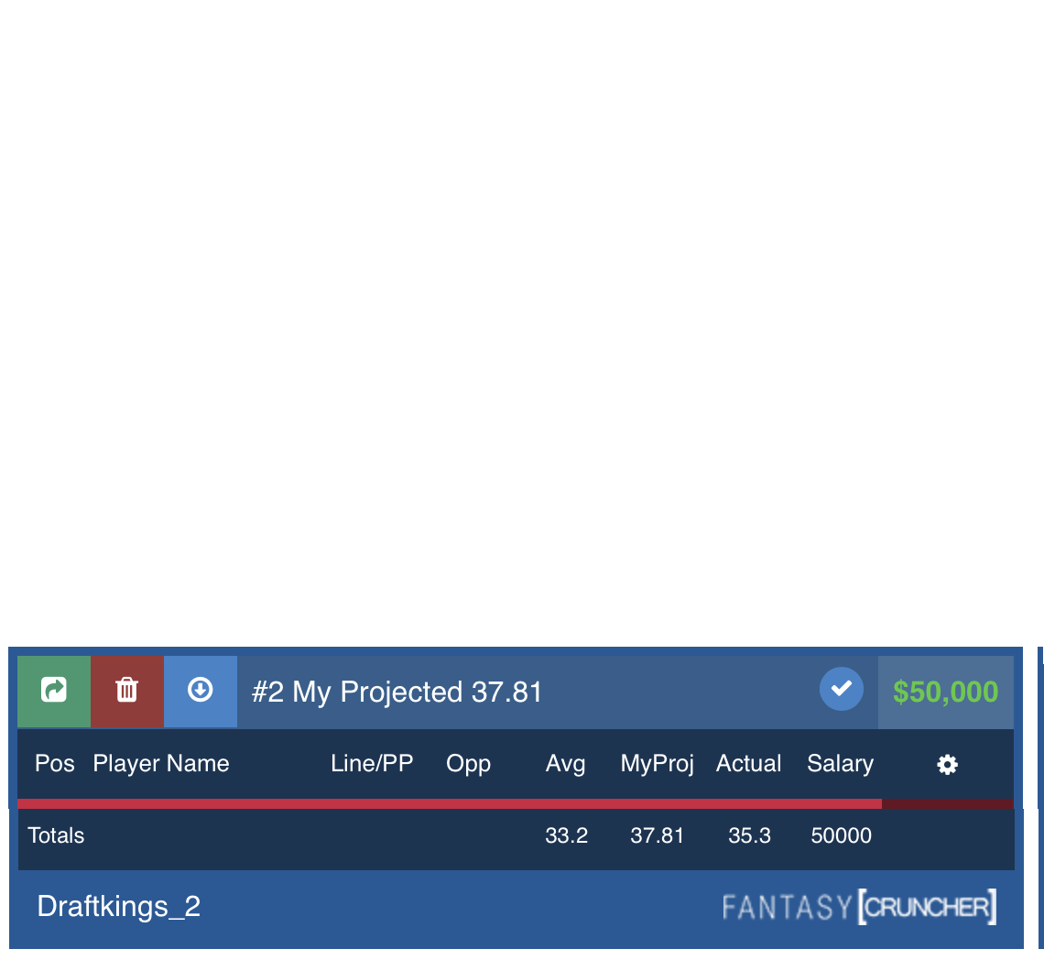
Non-Naïve Application
That said, the story is wildly different when there is minimal participation by a human. In these contests I told FantasyCruncher to limit the goalies to two options, chosen based on being the starting goalie for the team favored to win by the Las Vegas Casinos. I set the same assignment for the FantasyCruncher model but the scores were wildly different in this case. The Non-Naïve model is on the left, FantasyCruncher on the right.
In this case both set of contests would have cashed but the model would take a much higher prize while the in-house version would have scraped by.

Slide 18
Conclusions
While the model isn’t predictive enough to be a stand alone product, minimal human coaching can make it viable.
Significant challenges remain in finding more predictive features that aren’t multicollinear or otherwise reproductions of basic stats. Appropriate model selections for the type of distribution are important as well.
The moving averages have some promise, and perhaps an even simpler model based on those and core features might perform just as well.

Slide 19
Extensions
Further apply Las Vegas odds: Perhaps use those as a feature to inform models alongside the core metrics.
Consider strength of opponent metrics; marry the trends of the opposing teams to the basic stats. Perhaps facing tougher teams would significantly impact players.
Attempt an even simpler model with more stripped out features. Attempts were made based on position but some a revision might be in order with a core set of numbers.

Slide 20
Acknowledgements
I’d like to thank both my mentor for this course, Alex Rutherford, and my mentor through out my data science career, Michael Burton, for helping along the way to guide my progress, point out areas of improvement, and generally being great sounding boards. This project would be much less successful without them.

